Slide 1
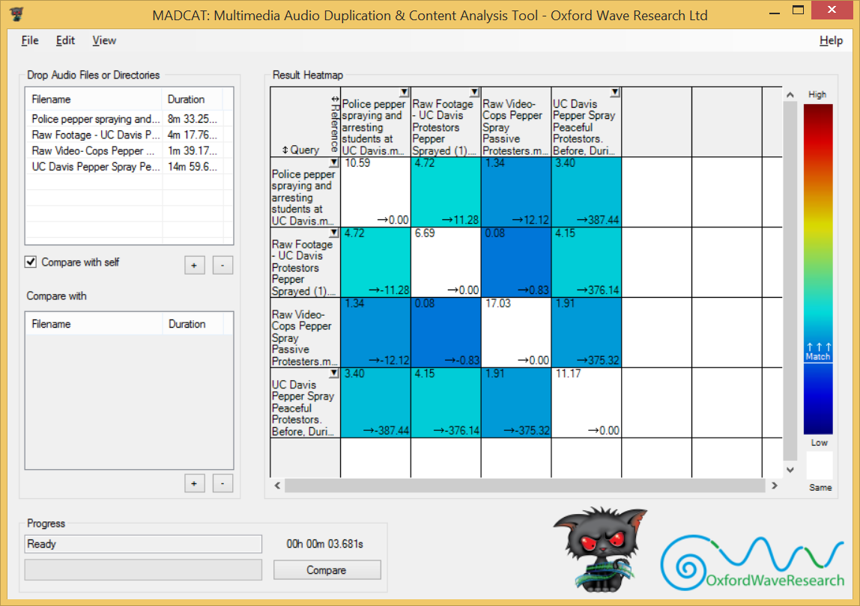
1
2
9
15
14
10
4
12
3
5
13
11
6
7
8

Slide 2
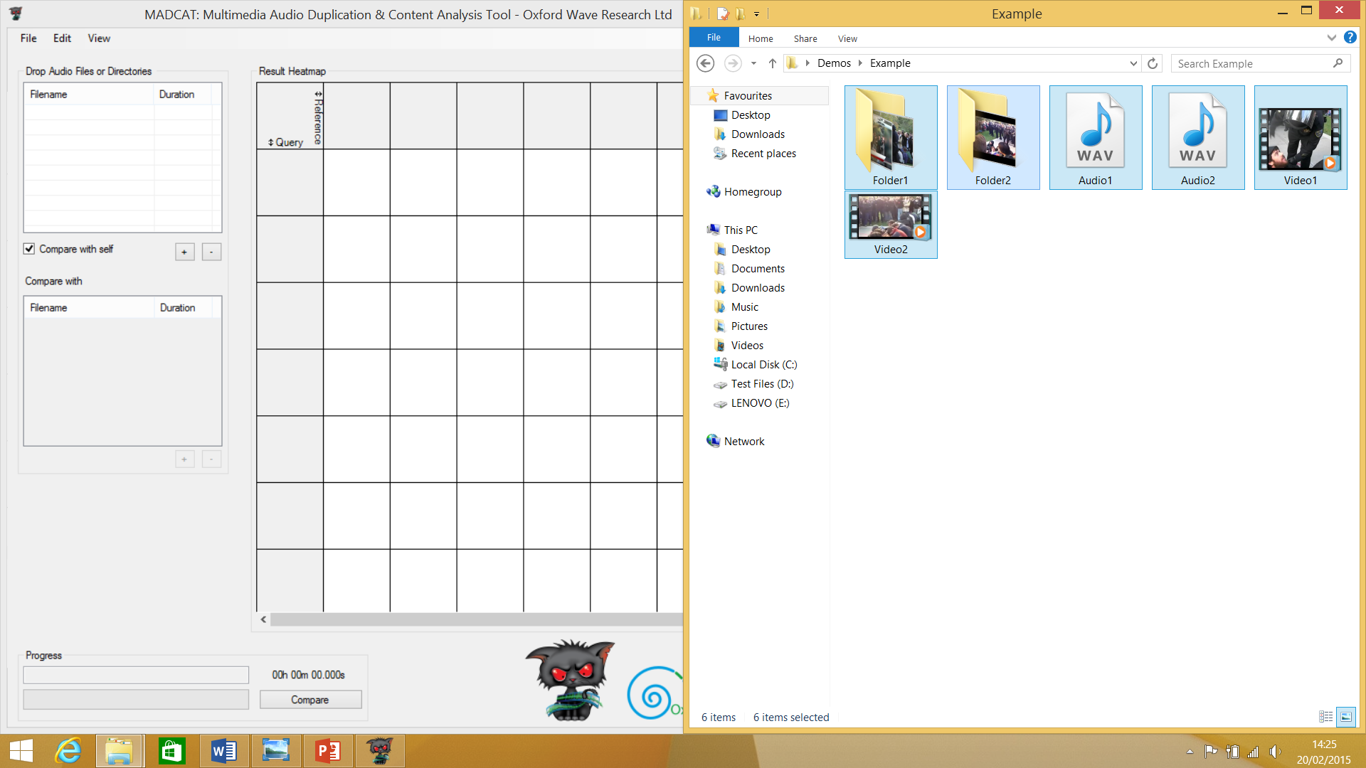
Drag the media files (or folders containing them) into the query files box

Slide 3
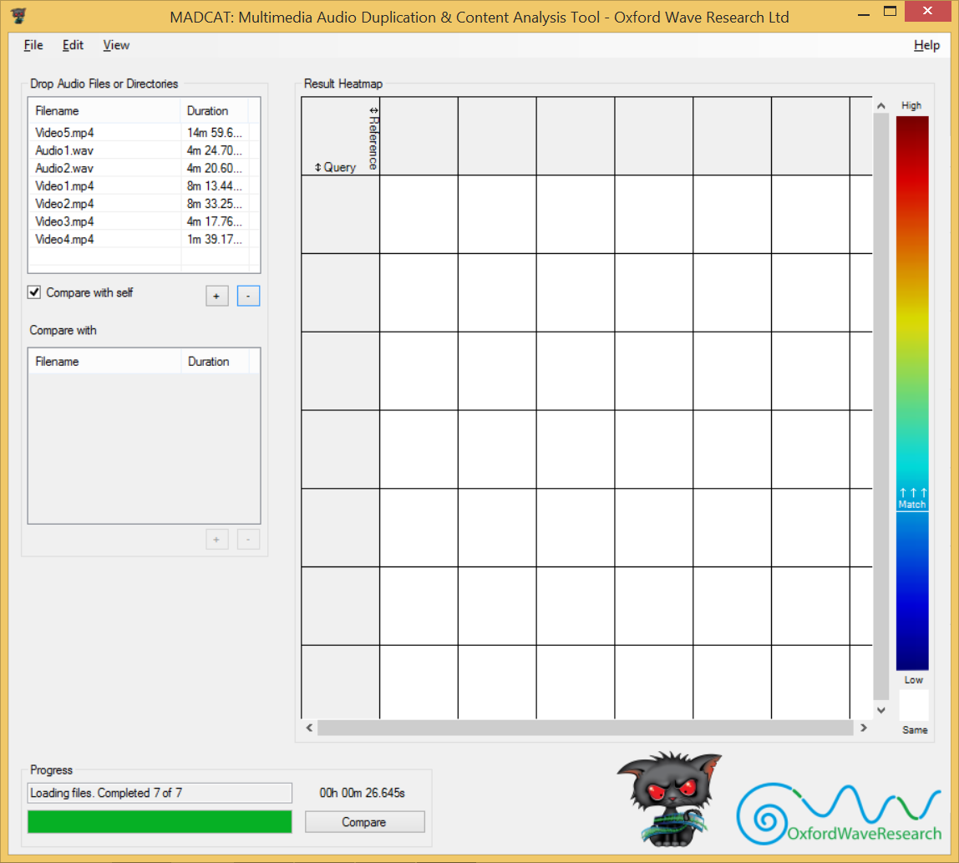
Wait until all files are loaded and click “Compare”

Slide 4
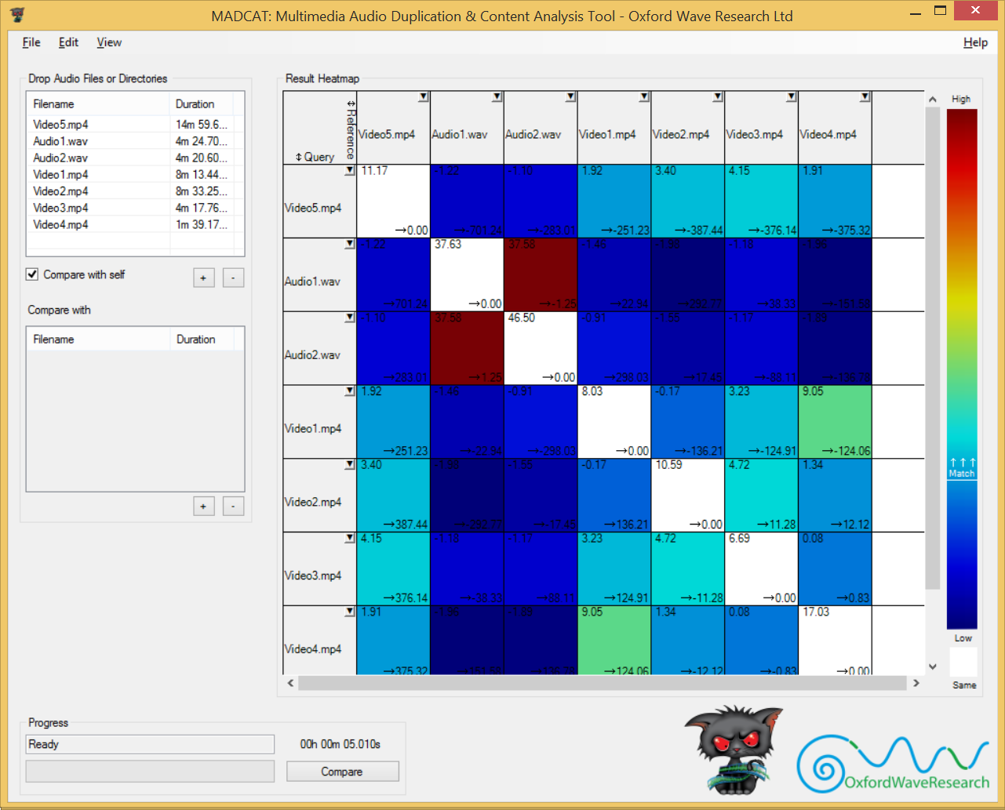
MadCat will then run a comparison and display the results

Slide 5
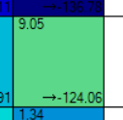
Match confidence value
Colour representing match confidence value
Time offset

Slide 6
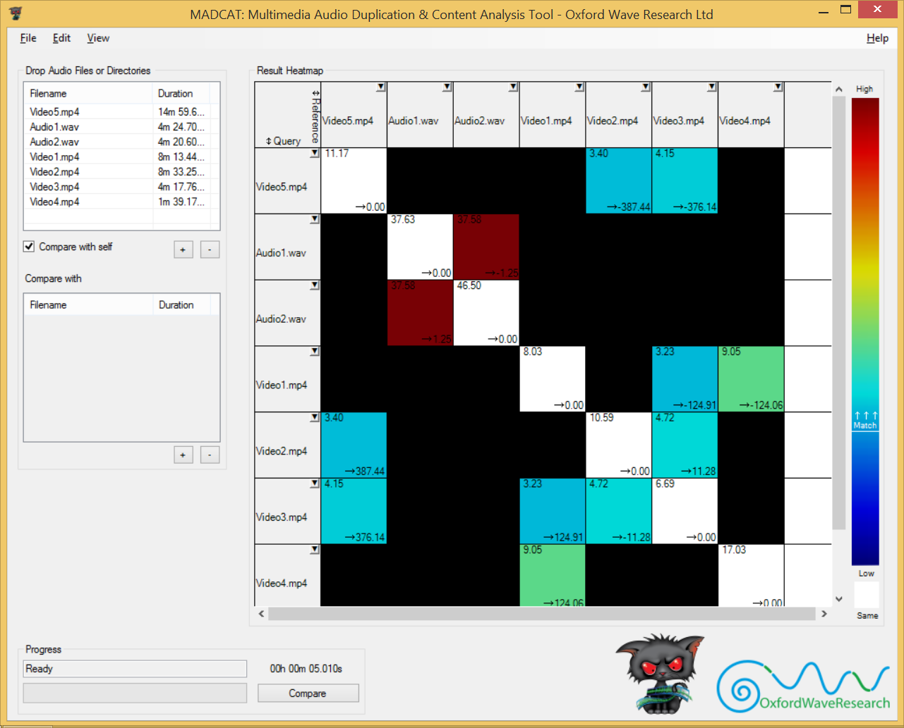
With “Hide non-matches” enabled, match squares with a lower confidence value than set match threshold will be black
Files with a higher match confidence than the set threshold will display as normal

